Slide 1
Introduction to Design Matrix & Response Vector
with the Cockcroft-Gault Formula
Computational Medicine
Notes:
Understanding features
Summer of Math Explanation 1

Slide 2
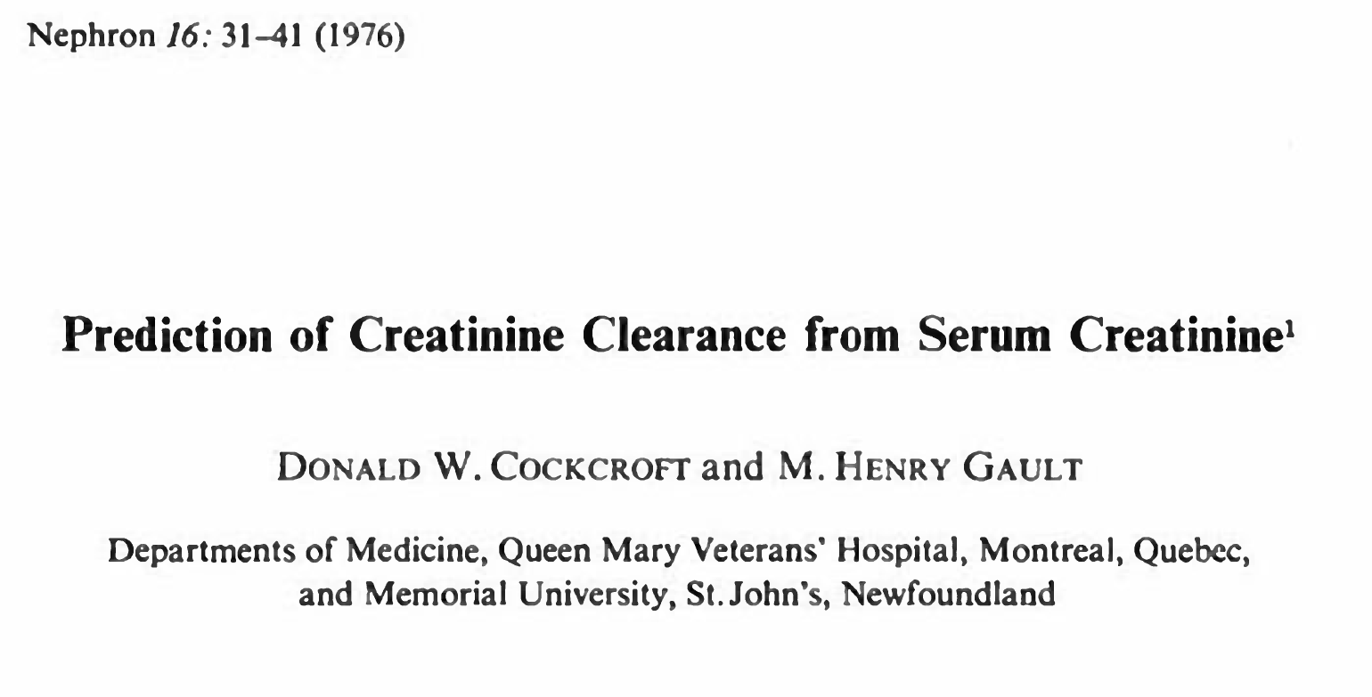
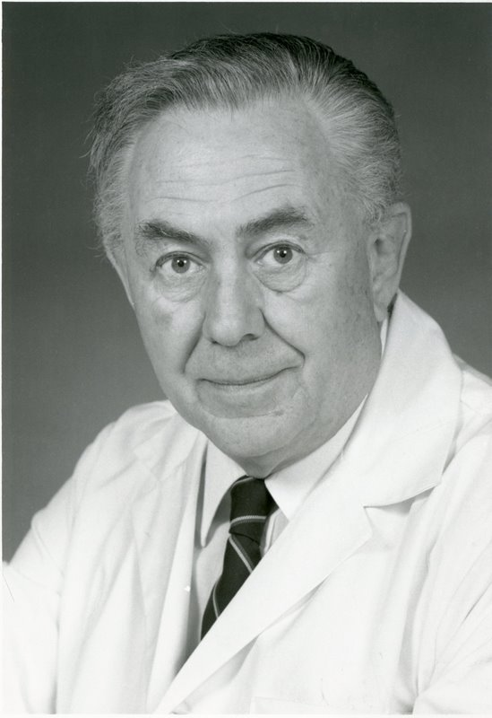


$$C_{cr}=\frac{140−age}{72⋅S_{cr}}$$
Henry M. Gault
Donald W. Cockcroft
Notes:
The Cockcroft-Gault Formula for estimating creatinine clearance

Slide 3
Disclosures
Assumption: the Cockcroft-Gault formula is perfectly accurate
The story’s narrative may be historically inaccurate
Notes:
Prediction of Creatinine Clearance is a Regression Problem

Slide 4
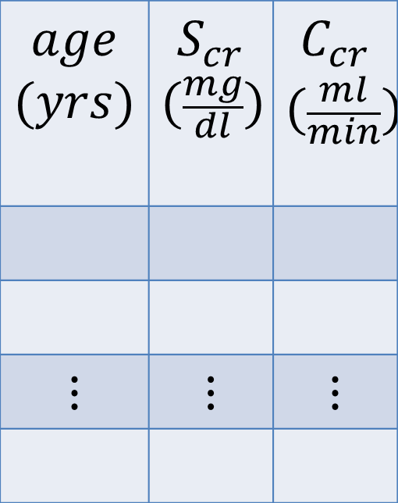



No. samples: $m=249$
No. features: $d=2$
Design matrix:
$$X=\left[\begin{matrix}age_{1} & {S_{cr}}_{1} \\ ⋮ & ⋮ \\ age_{249} & {S_{cr}}_{249}\end{matrix}\right]$$
Response vector:
$$\vec{y}=\left[\begin{matrix}{C_{cr}}_{1} \\ ⋮ \\ {C_{cr}}_{249}\end{matrix}\right]$$
$$∈ℝ^{m×d}$$
$$age$$ $$(yrs)$$ | $$S_{cr}$$ $$(\frac{mg}{dl})$$ | $$C_{cr}$$ $$(\frac{ml}{min})$$
$$⋮$$ | $$⋮$$ | $$⋮$$
$$∈ℝ^{m}$$

Slide 5

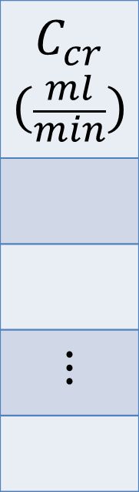
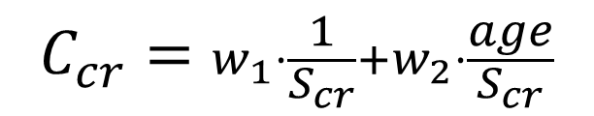
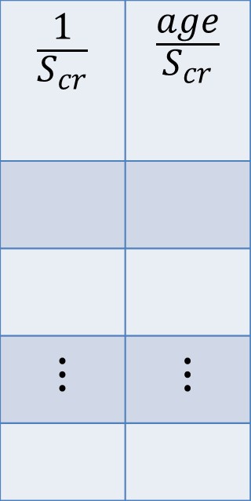
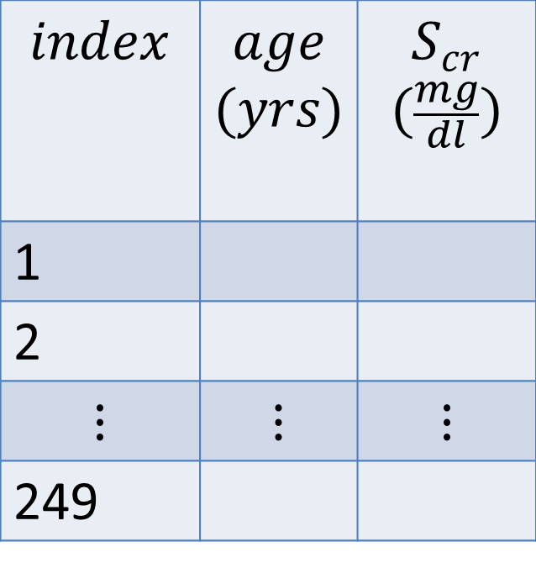
Age range: 18-92 $yrs$
$S_{cr}$ range (normal): 0.54-1.35$\frac{mg}{dl}$
$C_{cr}=w_{1}⋅S_{cr}+w_{2}⋅age$
$$C_{cr}=w_{1}⋅\frac{1}{S_{cr}}+w_{2}⋅\frac{age}{S_{cr}}$$
$$index$$ | $$age$$ $$(yrs)$$ | $$S_{cr}$$ $$(\frac{mg}{dl})$$
1
2
$$⋮$$ | $$⋮$$ | $$⋮$$
249
$$\frac{1}{S_{cr}}$$ | $$\frac{age}{S_{cr}}$$
$$⋮$$ | $$⋮$$
$$C_{cr}$$ $$(\frac{ml}{min})$$
$$⋮$$
Notes:
The w’s are coefficients

Slide 6
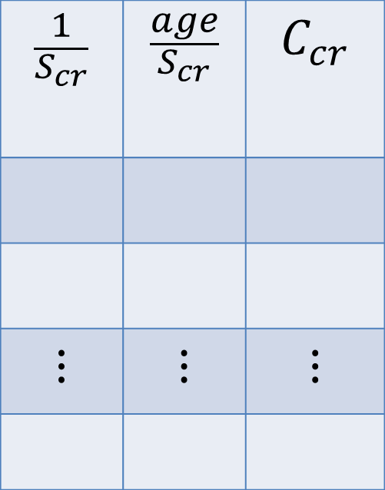
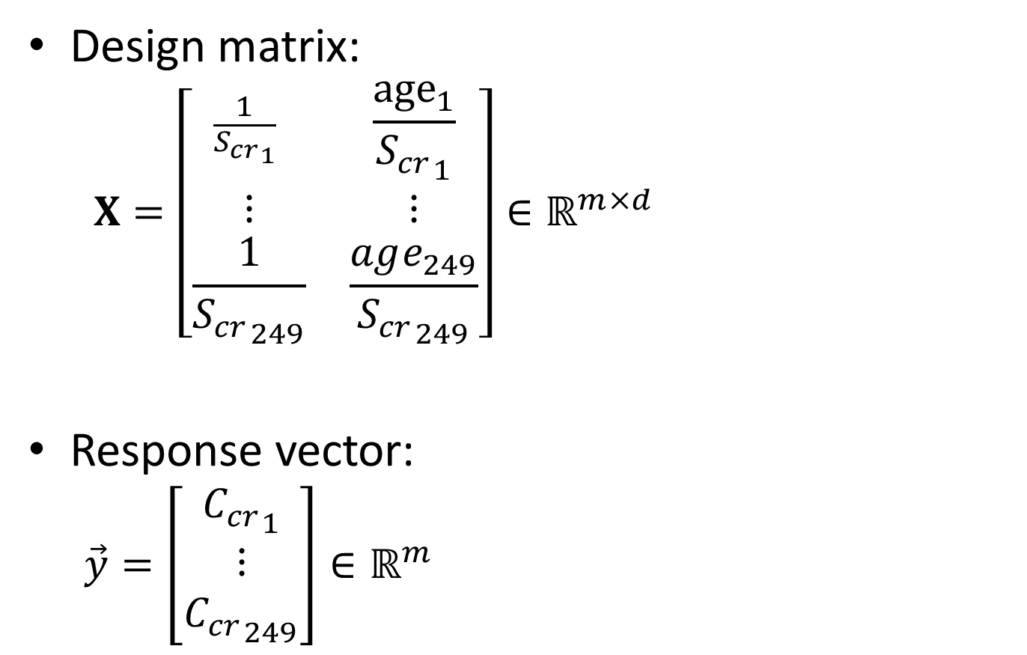
$$C_{cr}=w_{1}⋅\frac{1}{S_{cr}}+w_{2}⋅\frac{age}{S_{cr}}$$
Design matrix:
$$X=\left[\begin{matrix}\frac{1}{{S_{cr}}_{1}} & \frac{{age}_{1}}{{S_{cr}}_{1}} \\ ⋮ & ⋮ \\ \frac{1}{{S_{cr}}_{249}} & \frac{age_{249}}{{S_{cr}}_{249}}\end{matrix}\right]∈ℝ^{m×d}$$
Response vector:
$$\vec{y}=\left[\begin{matrix}{C_{cr}}_{1} \\ ⋮ \\ {C_{cr}}_{249}\end{matrix}\right]∈ℝ^{m}$$
$$\frac{1}{S_{cr}}$$ | $$\frac{age}{S_{cr}}$$ | $$C_{cr}$$
$$⋮$$ | $$⋮$$ | $$⋮$$

Slide 7

Solve…
$w_{1}=\frac{140}{72}, w_{2}=−\frac{1}{72}$
$C_{cr}=w_{1}⋅\frac{1}{S_{cr}}+w_{2}⋅\frac{age}{S_{cr}}$
$C_{cr}=\left(\frac{140}{72}\right)⋅\frac{1}{S_{cr}}+\left(−\frac{1}{72}\right)⋅\frac{age}{S_{cr}}=\frac{140−age}{72⋅S_{cr}}$

Slide 8

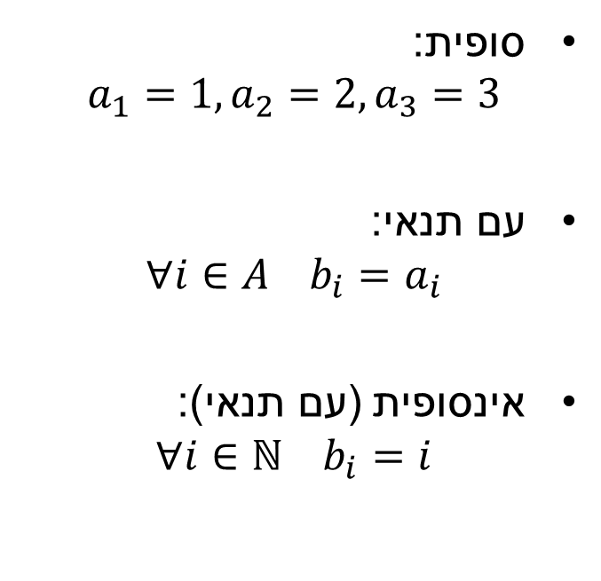
סדרה: קבוצה סדורה
קבוצה: אוסף של מספרים
סופית:
$$a_{1}=1, a_{2}=2, a_{3}=3$$
עם תנאי:
$$∀i∈A b_{i}=a_{i}$$
אינסופית (עם תנאי):
$$∀i∈ℕ b_{i}=i$$
סופית:
$$A=\{1, 2, 3\}$$
עם תנאי:
$$B=\{x|x∈A\}$$
אינסופית:
$$ℕ=\{1, 2, 3, …\}$$

